Slide 1


Noida Institute of Engineering and Technology, Greater Noida
ARM ARCHITECTURE FOR IoT
UNIT-IV
TARGET BOARD FRDM-KL25Z
Dr. Zatin Gupta
Associate Professor
B. Tech Fifth Semester
(Internet On Things)

Slide 2
Program Outcomes
1. Engineering knowledge: Apply the knowledge of mathematics, science, engineering fundamentals, and an engineering specialization for the solution of complex engineering problems.
2. Problem analysis: Identify, formulate, research literature, and analyse complex engineering problems reaching substantiated conclusions using first principles of mathematics, natural sciences, and engineering sciences.
3. Design/development of solutions: Design solutions for complex engineering problems and design system components or processes that meet the specified needs with appropriate consideration for public health and safety, and cultural, societal, and environmental considerations.
4. Conduct investigations of complex problems: Use research-based knowledge and research methods including design of experiments, analysis and interpretation of data, and synthesis of information to provide valid conclusions.
5. Modern tool usage: Create, select, and apply appropriate techniques, resources, and modern engineering and IT tools, including prediction and modeling to complex engineering activities, with an understanding of the limitations.
6. The engineer and society: Apply reasoning informed by the contextual knowledge to assess societal, health, safety, legal and cultural issues and the consequent responsibilities relevant to the professional engineering practice.
7. Environment and sustainability: Understand the impact of the professional engineering solutions in societal and environmental contexts, and demonstrate the knowledge of, and need for sustainable development.
8. Ethics: Apply ethical principles and commit to professional ethics and responsibilities and norms of the engineering practice.
9. Individual and team work: Function effectively as an individual, and as a member or leader in diverse teams, and in multidisciplinary settings.
10. Communication: Communicate effectively on complex engineering activities with the engineering community and with the society at large, such as, being able to comprehend and write effective reports and design documentation, make effective presentations, and give and receive clear instructions.
11. Project management and finance: Demonstrate knowledge and understanding of the engineering and management principles and apply these to one’s own work, as a member and leader in a team, to manage projects and in multidisciplinary environments.
12. Life-long learning: Recognize the need for, and have the preparation and ability to engage in independent and life-long learning in the broadest context of technological change.

Slide 3
Course Outcome
Course outcome: After completion of this course students will be able to
CO 1 | Describe ARM processor architectures. | K₁, K₂
CO 2 | Recognize ARM-based microcontrollers as modern IoT computing platforms. | K₁, K_{3,}
CO 3 | Realize Software design basics, software engineering principles. | K_{3,} K₄
CO4 | Explore Target Board FRDM-KL25Z for embedded system application. | K_{3,} K₄
CO 5 | Design smart IoT enabled devices using ARM. | K₂, K_{4,} K₅

Slide 4
ARM ARCHITECTURE FOR IoT |  |  |  |  |  |  |  |  | Year of Study: 2023-24
CO | PO1 | PO2 | PO3 | PO4 | PO5 | PO6 | PO7 | PO8 | PO9 | PO10 | PO11 | PO12
CO1 | 3 | 1 |  | 1 | 0 | 1 | 0 | 0 | 0 | 0 | 0 | 2
CO2 | 3 | 2 | 1 | 2 | 1 | 0 | 1 | 0 | 0 | 0 | 0 | 1
CO3 | 3 | 3 | 3 | 2 | 3 | 1 | 1 | 0 | 0 | 0 | 0 | 2
CO4 | 3 | 2 | 3 | 2 | 3 | 1 | 1 | 0 | 0 | 0 | 0 | 2
CO5 | 3 | 3 | 3 | 3 | 3 | 1 | 1 | 0 | 0 | 0 | 0 | 2
Average | 3 | 2.2 | 2.5 | 2 | 2 | 0.8 | 0.8 | 0 | 0 | 0 | 0 | 1.8

Slide 5
UNIT-IV | TARGET BOARD FRDM-KL25Z
Introduction & Features, General Purpose I/O, Freedom KL25Z, KL25Z GPIO Ports, Control Registers, Program, Clocking Logic, Interfacing, Timers: KL25 Timer Peripherals, Periodic Interrupt Timer, Timer/PWM Module (TPM), Modes of operation, Major Channel Modes, Wind Speed Indicator (Anemometer), Pulse-Width Modulation, Low Power Timer (LPTMR).

Slide 6
KL25Z-Introduction
KL25Z is an ARM-M0 based Microprocessor board.
It has been popularly known as FRDM-KL25Z board.
It has been designed by Freescale in collaboration with mbed for prototyping all sorts of devices, especially those requiring the size and price point offered by Cortex-M0+ and the power of USB Host and Device.
Mbed is a platform and operating system for internet-connected devices based on 32-bit ARM Cortex-M microcontrollers
It is packaged as a development board with connectors to break out to strip board and breadboard, and includes a built-in USB FLASH programmer.

Slide 7
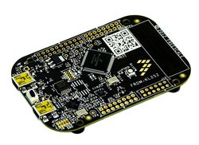
KL25Z-Features
Features include easy access to MCU I/O, battery-ready, low-power operation, a standard-based form factor with expansion board options and a built-in debug interface for flash programming and run-control. The FRDM-KL25Z is supported by a range of NXP and third-party development software.
*Form factor is a hardware design aspect that defines and prescribes the size, shape, and other physical specifications of components, particularly in electronics

Slide 8
FRDM-KL-25Z Features
5V USB or 4.5-9V supply
High performance ARM® Cortex™-M0+ Core
48MHz,
16KB RAM,
128KB FLASH
USB (Host/Device): Built-in USB drag 'n' drop FLASH programmer
Serial Peripheral Interface (SPI) (2)
Inter Connect IC (I2C) (2)
Universal Asynchronized Receiver Transmitter(UART) (3)
Pulse Width Modulation(PWM)
16 bit-Analog to Digital Convertor(ADC)
1x 12bit Digital to Analog Convertor(DAC)
GPIO (66)

Slide 9
NXP KL25Z Features
FRDM-KL25Z Onboard actuators and Sensors
MMA8451Q - 3-axis accelerometer
Capacitive touch sensor
Tri-color (RGB) LED
2-RED LEDs

Slide 10
KL25Z hardware review
mbed HDK & SDK enabled
Drag-n-drop programming
Flexible power supply options – USB, coin cell battery, external source
CMSIS-The Common Microcontroller Software Interface Standard (CMSIS) is a vendor-independent abstraction layer for microcontrollers that are based on Arm Cortex processors.
Online development tools
Easy to use C/C++ SDK
Lots of published libraries and projects
MKL25Z128VLK4 in an 80 QFP package
Battery-ready, power-measurement access points
Easy access to MCU I/O via Arduino ™ R3 compatible I/O connectors
Mass storage device flash programming interface
P&E Debug interface provides run-control debugging and compatibility with IDE tools
Data logging application
Open SDA: OpenSDA is an open-standard serial and debug adapter.

Slide 11
Functional Block diagram of KL25-Z

Slide 12
Functional Block diagram of KL25-Z

Slide 13
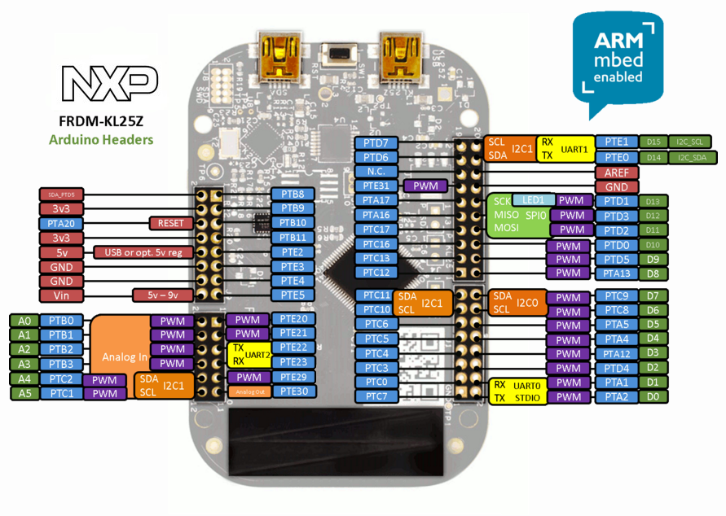
GPIO:Genral Purpose Input Output

Slide 14
GPIO: Connectors
There are four Jacks Connectors in KL25z J1(16-pin), J2 (20-pins), J9( 16 pins) and J10(12-pins)

Slide 15
GPIO PORTS
The port control and interrupt (PORT) module provides support for port control, and external interrupt functions.
There are five 32-bit ports available in KL25Z.
PORT-A(PTA)
PORT-B(PTB)
PORT-C(PTC)
PORT-D(PTD)
PORT-E(PTE)
All PORTs of KL25Z is having different registers for its configuration and commands

Slide 16
PORT Features
The PORT module has the following features:
Pin interrupt on selected pins
Interrupt flag and enable registers for each pin
Individual pull control fields with pullup, pulldown, and pull-disable support on selected pins
Individual drive strength field supporting high and low drive strength on selected pins
Individual input passive filter field supporting enable and disable selected pins
• Individual mux control field supporting analog or pin disabled,
• Pad configuration fields are functional in all digital Pin Muxing modes

Slide 17
PORT Control Registers
All PORT of KL25Z is having different registers for its configuration and commands
Acronym | Register Name | Task
PCR | Pin Control Register | Interrupt Status Flag, Interrupt Configuration , Pin Mux Control ,Drive Strength Enable, Passive Filter Enable, Slew Rate Enable, Pull Enable and Pull Select.
GPCLR | Global Pin Control Low Register | 32-bit writes with enable control.
GPCHR | Global Pin Control High Register | 32-bit writes with enable control.
ISFR | Interrupt Status Flag Register | Read only to see interrupt status on corresponding bit.

Slide 18
Pin Control Register(PCR)
Bit 24: ISF: interrupt Status Flag, 0 not detected 1 detected
Bit 19–16
Bit 10–8: MUX: Pin Mux Control is IRQC: Interrupt Configuration,
000(Analog)
001 Alternative 1 (GPIO).
Other Alternative 2 (chip-specific).
Bit 6 DSE: Drive Strength Enable
Bit 4 PFE: Passive Filter Enable
Bit 2 SRE: Slew Rate Enable
Bit 1 PE: Pull Enable
Bit 0 PS: Pull Select

Slide 19
Global Pin Control Low Register (PORTx_GPCLR)
Only 32-bit writes are supported to this register.

Slide 20
Global Pin Control High Register (PORTx_GPCHR)
Only 32-bit writes are supported to this register.

Slide 21
Interrupt Status Flag Register (PORTx_ISFR)

Slide 22
LED blink using Cortex-M0+
#include <MKL25Z4.h>
#include <math.h>
void delay(int n){
int i;
for(i=0;i<n;i++);
}
int main()
{
SIM->SCGC5 |=0x0400;
PORTB->PCR[18]=0x0100;
PTB->PDOR =0x40000;
PTB->PDDR =0x40000;
while(1){
PTB->PCOR=0x40000;
delay(5000000);
PTB->PSOR=0x40000;
delay(5000000);
}
}

Slide 23
Clocking diagram

Slide 24
Multipurpose Clock Generator (MCG)
The selection and multiplexing of system clock sources is controlled and programmed via the MCG module.
The setting of clock dividers and module clock gating for the system are programmed via the SIM module

Slide 25
System integration module (SIM)
The system integration module (SIM) provides system control and chip configuration registers.
Features
• System clocking configuration
• System clock divide values
• Architectural clock gating control
• ERCLK32K clock selection
• USB clock selection
• UART0 and TPM clock selection
• Flash and System RAM size configuration
• USB regulator configuration
• TPM external clock and input capture selection
• UART receive/transmit source selection/configuration
The SIM module contains many bitfields for selecting the clock source and dividers for various module clocks. The SIM registers can be written only in supervisor mode. In user mode, write accesses are blocked and will result in a bus error.

Slide 26
Interfacing using GPIO
The general-purpose input and output (GPIO) module communicates to the processor core via a zero wait state interface for maximum pin performance. The GPIO registers support 8-bit, 16-bit or 32-bit accesses.
The GPIO data direction and output data registers control the direction and output data of each pin when the pin is configured for the GPIO function. The GPIO input data register displays the logic value on each pin when the pin is configured for any digital function, provided the corresponding Port Control and Interrupt module for that pin is enabled.
Efficient bit manipulation of the general-purpose outputs is supported through the addition of set, clear, and toggle write-only registers for each port output data register.

Slide 27
GPIO Control Registers
Acronym | Register Name | Task | Example
PDOR | Port Data Output Register | Initial configures the logic levels | PTB->PDOR =0x00040000;
PDDR | Port Data Direction Register | Configure input or output | PTA->PDDR =0x0000FFFF; 0 for input and 1 for output
PCOR | Port Clear Output Register | register configures whether to clear the fields | PTC->PCOR=0x00000055;
PSOR | Port Set Output Register | register configures whether to set the fields | PTA->PSOR=0x00000067;
PTOR | Port Toggle Output Register | register will toggle the contents of the corresponding bit | PTB->PTOR =0x00000006;
PDIR | Port Data Input Register | Port Data Input which is set to 0 | PTE->PDIR=0x000000AA;

Slide 28
Timer modules
The following timer modules are available on this device:

Slide 29
Timer/PWM Module (TPM)
The TPM (Timer/PWM Module) is a two to eight channel timer which supports input capture, output compare, and the generation of PWM signals to control electric motor and power management applications.
The counter, compare and capture registers are clocked by an asynchronous clock that can remain enabled in low power modes.

Slide 30
TPM Features
TPM clock mode is selectable as it Can increment on every edge of the asynchronous counter clock or Can increment on rising edge of an external clock input synchronized to the asynchronous counter clock
Pre-scaler divide-by 1, 2, 4, 8, 16, 32, 64, or 128
TPM includes a 16-bit counter
It can be a free-running counter or modulo counter
The counting can be up or up-down
Includes 6 channels that can be configured for input capture, output compare, or edge-aligned PWM mode
In input capture mode the capture can occur on rising edges, falling edges or both edges
In output compare mode the output signal can be set, cleared, pulsed, or toggled on match
All channels can be configured for center-aligned PWM mode
Support the generation of an interrupt and/or DMA request per channel
Support the generation of an interrupt and/or DMA request when the counter overflows
Support selectable trigger input to optionally reset or cause the counter to start incrementing.
The counter can also optionally stop incrementing on counter overflow
Support the generation of hardware triggers when the counter overflows and per channel

Slide 31
TPM Modes of Operation
During debug mode, the TPM can be configured to temporarily pause all counting until the core returns to normal user operating mode or to operate normally. When the counter is paused, trigger inputs and input capture events are ignored.
During doze mode, the TPM can be configured to operate normally or to pause all counting for the duration of doze mode. When the counter is paused, trigger inputs and input capture events are ignored.
During stop mode, the TPM counter clock can remain functional and the TPM can generate an asynchronous interrupt to exit the MCU from stop mode.

Slide 32
TPM block diagram

Slide 33
Major Channel Modes in TPM
MSnB, MSnA, ELSnB and ELSnA signals decides the channel input capture mode logic

Slide 34
Pulse-Width Modulation (PWM) in TPM
There are two types of PWM in TPM:
Edge-Aligned PWM (EPWM) Mode
The EPWM period is determined by (MOD + 0x0001) and the pulse width (duty cycle) is determined by CnV.

Slide 35
2. Centre-Aligned PWM (CPWM) Mode
The CPWM pulse width (duty cycle) is determined by 2 × CnV and the period is determined by 2 × MOD

Slide 36
Periodic Interrupt Timer (PIT)
The PIT module is an array of timers that can be used to raise interrupts and trigger DMA channels.

Slide 37
PIT Features
The main features of this block are:
Ability of timers to generate DMA trigger pulses
Ability of timers to generate interrupts
Maskable interrupts
Independent timeout periods for each timer

Slide 38
Low-Power Timer (LPTMR)
The low-power timer (LPTMR) can be configured to operate as a time counter with optional pre-scaler, or as a pulse counter with optional glitch filter, across all power modes, including the low-leakage modes.
It can also continue operating through most system reset events, allowing it to be used as a time of day counter.

Slide 39
LPTMR Features
The features of the LPTMR module include:
16-bit time counter or pulse counter with compare
Optional interrupt can generate asynchronous wakeup from any low-power mode
Hardware trigger output
Counter supports free-running mode or reset on compare
Configurable clock source for prescaler/glitch filter
Configurable input source for pulse counter
Rising-edge or falling-edge

Slide 40
LPTMR Modes of operation

Slide 41
PWM (Pulse Width Modulation) anemometers
An anemometer is an instrument used to measure the speed or velocity of air (gases) either in a contained flow, such as airflow in a duct, or in unconfined flows, such as atmospheric wind. To determine the air velocity, anemometers detect change in some physical property of the fluid or the effect of the fluid on a mechanical device inserted into the flow.
PWM (Pulse Width Modulation) anemometers are also used, wherein the velocity is inferred by the time length of a repeating pulse of current that brings the wire up to a specified resistance and then stops until a threshold "floor" is reached, at which time the pulse is sent again.

Slide 43
Sample MCQ
16 bit-Analog to Digital Convertor(ADC) of FRDM-KL25z with Analog reference voltage of 5-Volt will have voltage sensitivity of __________.
(a) 76.3 Micro-Volt (b) 76.3 Milli-Volt (c) 0.3125 volt (d) 3.2 Volt
Select the platform which used in 32-bit ARM Cortex-M microcontrollers?
(a) Kbed (b) Sbed (c) Mbed (d) Zbed
Name the organisation who designed FRDM-KL25Z?
(a) ScaleFree (b) Scale (c) Freescale (d) No Scale
What will happen when ARM processor use pipeline?
(a) Throughput increase and latency increase
(b) Throughput decrease and latency increase
(c) Throughput increase and latency decrease
(d) Throughput decrease and latency decrease
GPIO of ARM KL-25z board has______.
(a) Filter (b) pull up (c) PWM (d) All of above

Slide 44
Thank You

